Slide 1
Python sequence work and alignments (Biopython)
Sonja Beck, Jule Brenningmeyer und Maral Demirseçen | Geobiotechnologie

Slide 2

Table of Contents
Task 1: Preparing Sequences
Download sequence from NCBI
Fasta format
Genbank format
Biopython
read, export, manipulate
Task 2: Sequence characteristics
Task 3: Global alignment of protein sequences
Task 4: Phylogenetic tree
Notes:
tool describing the diversity of sequences

Slide 3
Download sequence from NCBI
Example: RdhA Sequence from dehalococcoides strain CBDB1
Gen: rdhA
Protein: reductive dehalogenase
Paper: Genome sequence of the chlorinated compound–respiring bacterium Dehalococcoides species strain CBDB1 (2005, PUBMED: 16116419)
Dehalococcoides species are strictly anaerobic bacteria
Rdh genes, possibly conferring on the bacteria an immense dehalogenating potential

Slide 4


Slide 5
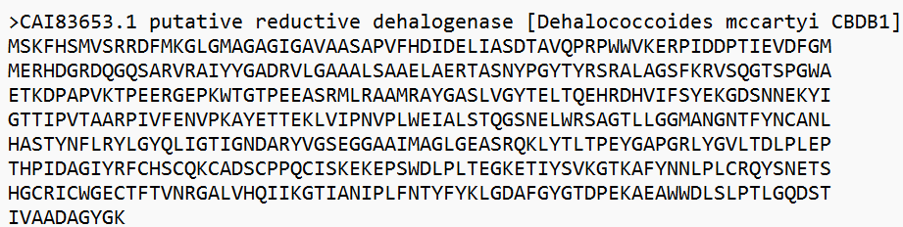
Fasta Format
A simple sequence data file format
For amino acid and nucleotide sequences
Filename: .fasta, .fna, .ffn, .faa, .frn, .fa
The first line starts with a " > " and is used as a summary description (number + name)
library accession number

Slide 6
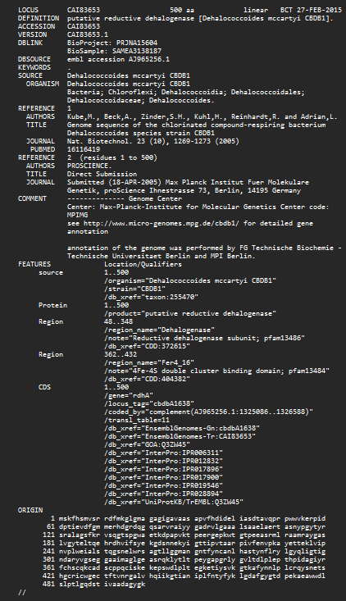
Genbank Format
Contains storage space for additional informations
For better human interpretation
ORIGIN denotes the DNA or protein sequence
Essential parts are ORIGIN, LOCUS, DEFINITION, ACCESSION and VERSION
The rest can be missed
Ends with “//” and indicates the end of the entry/file

Slide 7

Short introduction into Biopython
Open-source tools for biological and bioinformatics computation written in Python
Contains classes to represent biological sequences and sequence annotations
With separate modules sequence alignment, protein structure, population genetics, phylogenetics, sequence motifs, and machine learning.
Accessing online databases (ex: NCBI) of biological information
Some of the things you can do:
Phylogeny, Genome diagrams, Macromolecular structure, Wrappers (BLAST, Clustal, PhyML, EMBOSS and SAMtools)
Notes:
https://en.wikipedia.org/wiki/Biopython

Slide 8
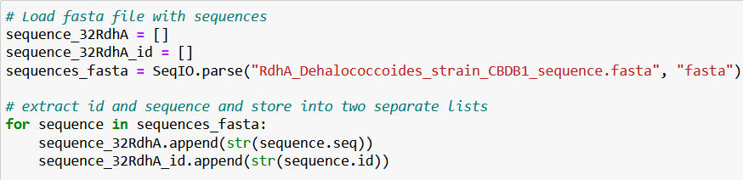
Read
Bio.SeqIO as standard input/output interface for BioPython
Bio.SeqIO.parse() takes file and format name and returns SeqRecord iterator
append() adds item to the end of a list

Slide 9
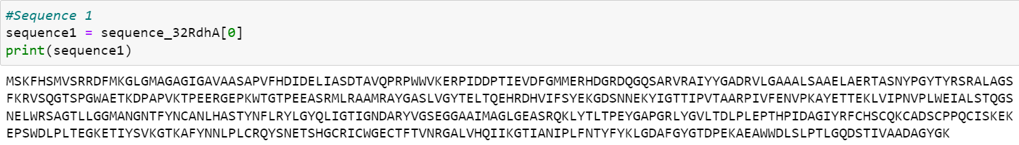
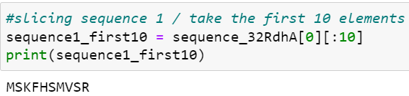
Manipulate
Notes:
After we read in our sequences and saved them as a list, we can select single sequences or subsequences and manipulate them.
Therefore we first select our first sequence from the list

Slide 10
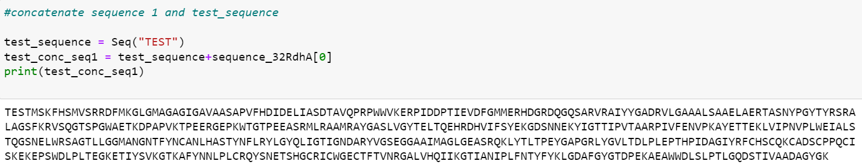
Manipulate

Slide 11
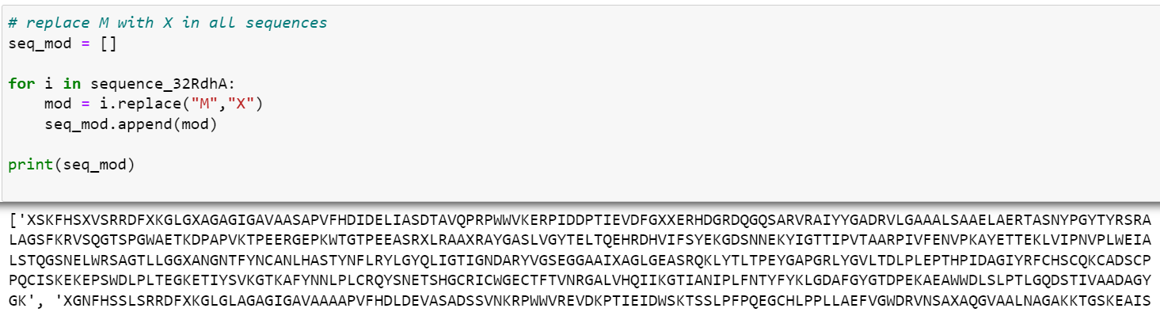
Manipulate

Slide 12
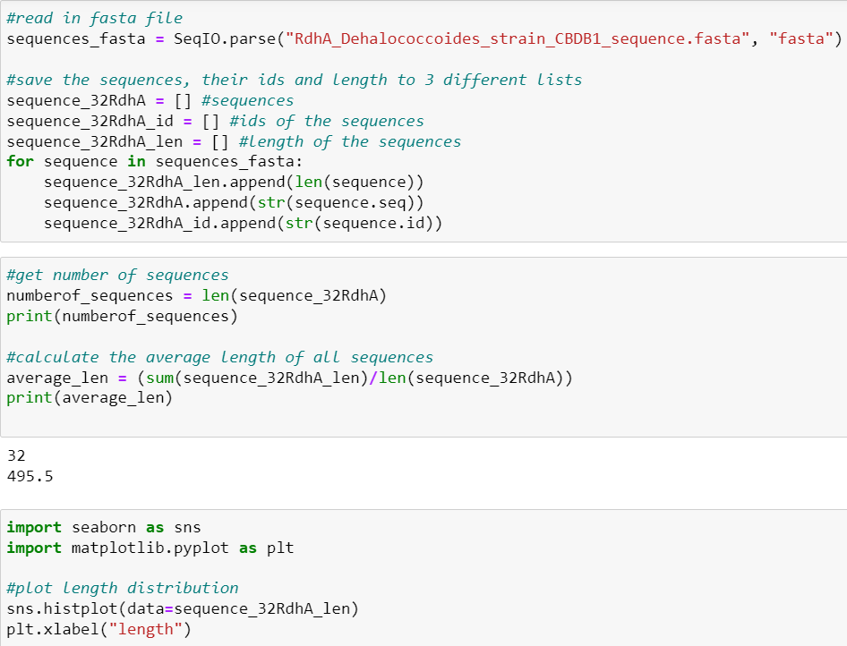
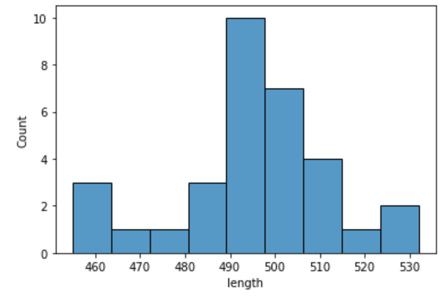
Number downloaded sequences, average length, length distribution

Slide 13
Local vs global alignment
Global alignment (Needleman and Wunsch (1970)):
alignment over the full length of both sequences (when two sequences have similar or roughly the same length)
If not much information about the relationship about two sequences available: Local alignment (Smith and Waterman (1981)) with Smith-Waterman Algorithm (small modification of DP)
selection of best scoring subsequence from each sequence
Notes:
Then lets talk about local and global alignment now. Alignments are used to compare two sequences and give back a score which indicates the compatibility between aligned sequences and highly compatible sequences should be given positive scores, and incompatible ones should be given negative scores. Global alignments …
in general global alignment is more suitable for close related sequences
Therefore and in general global alignment is more suitable for close related sequences.
local alignment is more suitable for divergent or distantly related sequences
Problem: When similarity limited only to a domain of sequence -> misalignment of related fragments with unrelated part -> score maybe does not recognize any similarity

Slide 14
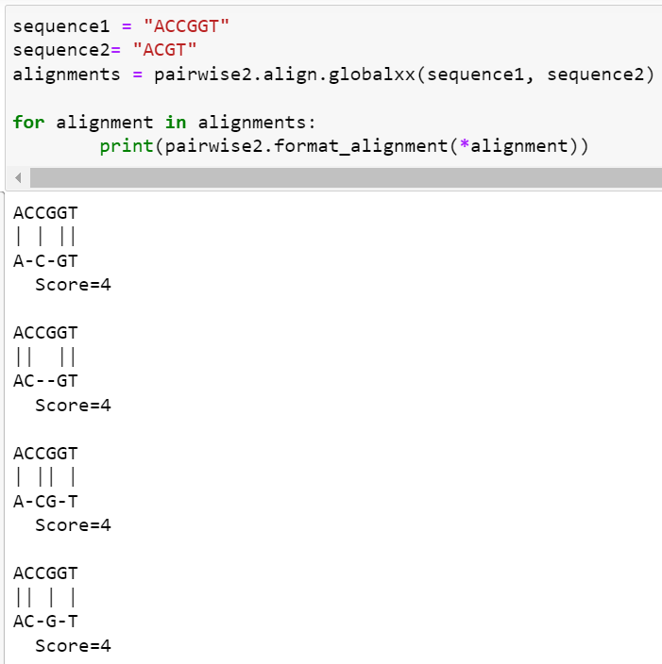
Alignments
Bio.pairwise2 module for pairwise sequence alignment using dynamic programming algorithm
object align contains all different alignment functions
format_alignment shows aligned parts of the sequences
I → match: 1
ᐧ → mismatch: 0
- → gap-penalty: 0
Notes:
Here you can see, our code to get the global alignment. And first I will explain it to you on an example DNA-Sequence. The modul pairwise2 provides functions to get global alignments between two sequences and the modul align contains all the different alignment functions.
When doing alignments, you can specify the match score, mismatch score and gap penalties. This has an effect on the score, but also on how the sequences align to each other.
To tell python how we want to set our parameters we use globalXX . Global says that it is a global alignment and the first X means that our match-score is 1 and the mismatch-score is 0 and the second letter is for the gap penalty, which is in this case X and indicates that the gap penalty is 0.
For a nice printout, we use the format_alignment method.
Our code returns all Alignments with the highest score. In this case the highest score that can be achieved is 4.

Slide 15
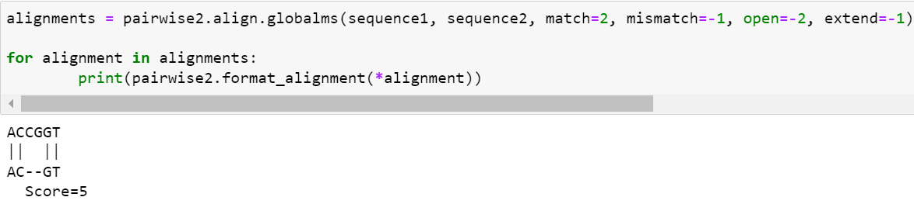
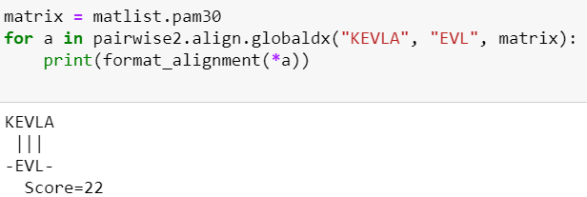
Alignments
I → match: 2
ᐧ → mismatch: -1
- → gap-penalty: -1
open gap: -2
Notes:
open gap
m → means we can set the parameters by writing them in the following braces
s→ means we have gap penalty (extend) and open gap and have to define them asa well
d → means we define the scoring-matrix first and write the matrix which should be used in the braces

Slide 16
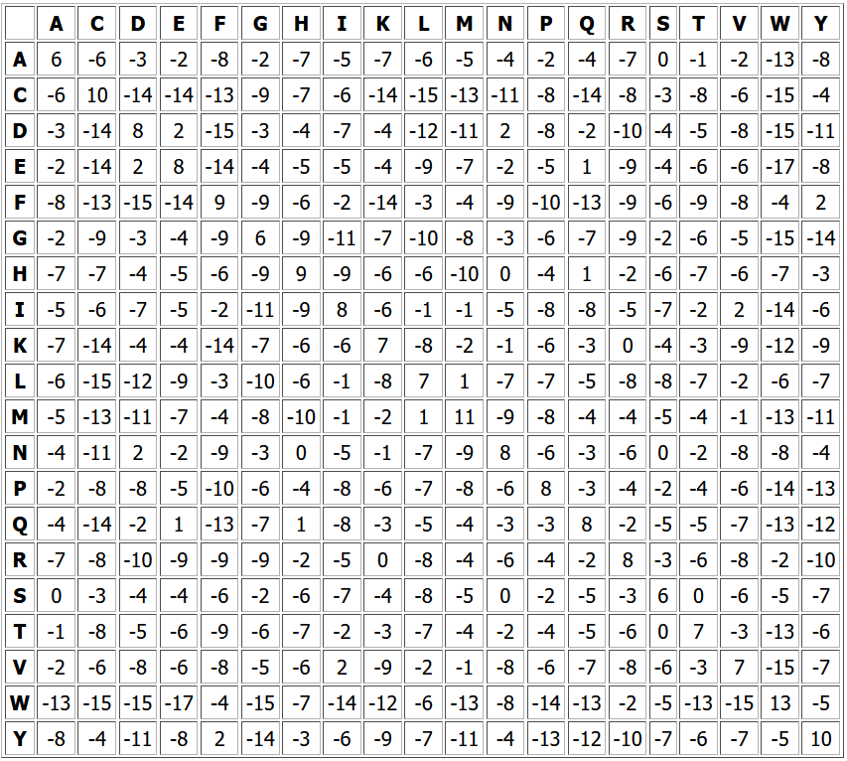
Substitution matrix
contain values proportional to probability that amino acid A mutates into amino acid B
two major matrices types: BLOSUM (local) and PAM (global alignment)
Point-accepted mutation (PAM)
developed by Margaret Dayhoff in 1970s (one of the firsts)
based on global alignments of closely related proteins (>85% identity)
PAM1: frequency of mutation normalized for 1%
→ extrapolated for rest
PAM 30 (75% identity) often used
Notes:
Point accepted mutation
PAM250 -> 20% identity
PAM30 -> 75% identity

Slide 17
Usage of amino acid vs nucleotide sequence
Amino acid sequence
DNA mutations can be synonymous
→ Overestimation of sequence divergence
20x20 matrix more finely expressing for evolutionary relationships
DNA includes non-coding sequences
→ reveals more distant relationships e.g. search for plant globins with human beta globin
Nucleotide sequence
→ study noncoding regions e.g. introns, DNA polymorphisms
Notes:
evolutionary selection pressure exerted on protein sequence

Slide 18
Structure of program
Read in fasta-files
install packages and read with function SeqIO.parse()
save sequences and ids in two separate lists
Global alignment of sequences
user decision if all (1) or only two sequences (2) should be aligned
aligning sequences with Bio.pairwise2 with object align and PAM 30 matrix from MatrixInfo from Bio.SubsMat
print out results with format_alignment
Write results into new file
with open user file and using write() to export the results into this

Slide 19
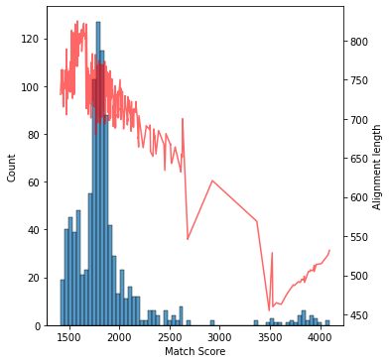
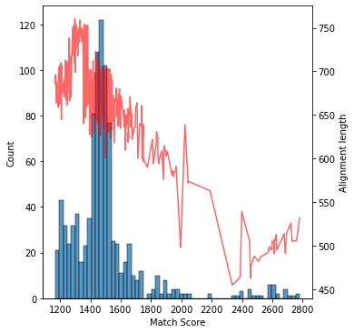
Score distribution of complete alignment
PAM 30
PAM 250

Slide 20
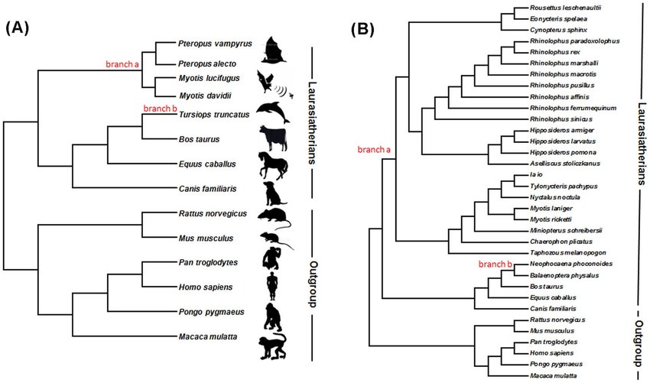
Phylogenetic Tree
Tool describing diversity of sequences
Tree diagram showing the evolutionary relationships
Connections and Patterns
As you move from the root to the tips, you are moving forward in time.
Trace a species back through evolutionary history!
How? : Down the branches of the tree, and locate their common ancestry along the way
Root -> Ancestral lineage ; Tips -> Descendants
Split -> Branching on a Phylogeny = Speciation!

Slide 21
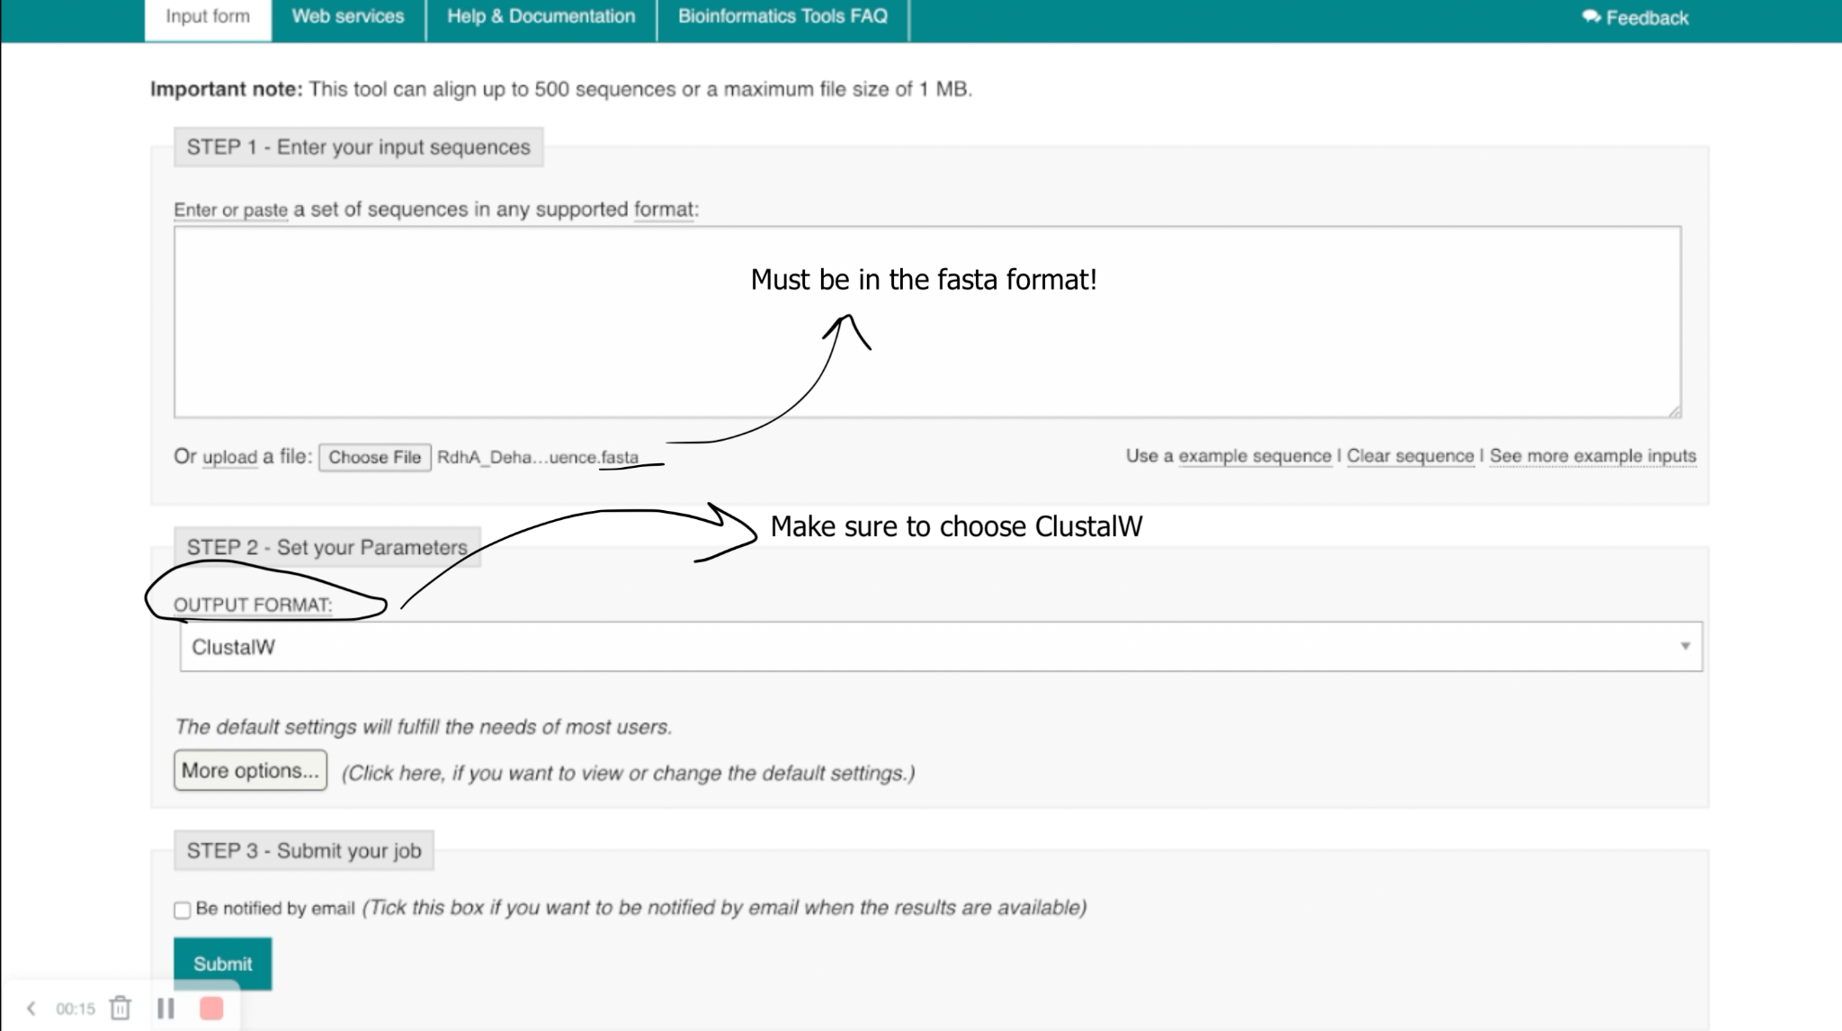
Multiple Sequence Alignment with Muscle

Slide 22
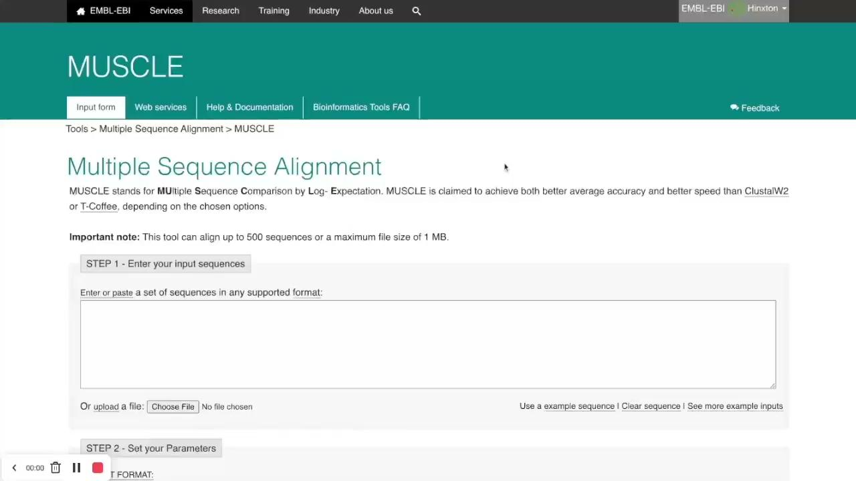
Multiple Sequence Alignment with Muscle - Demo

Slide 23
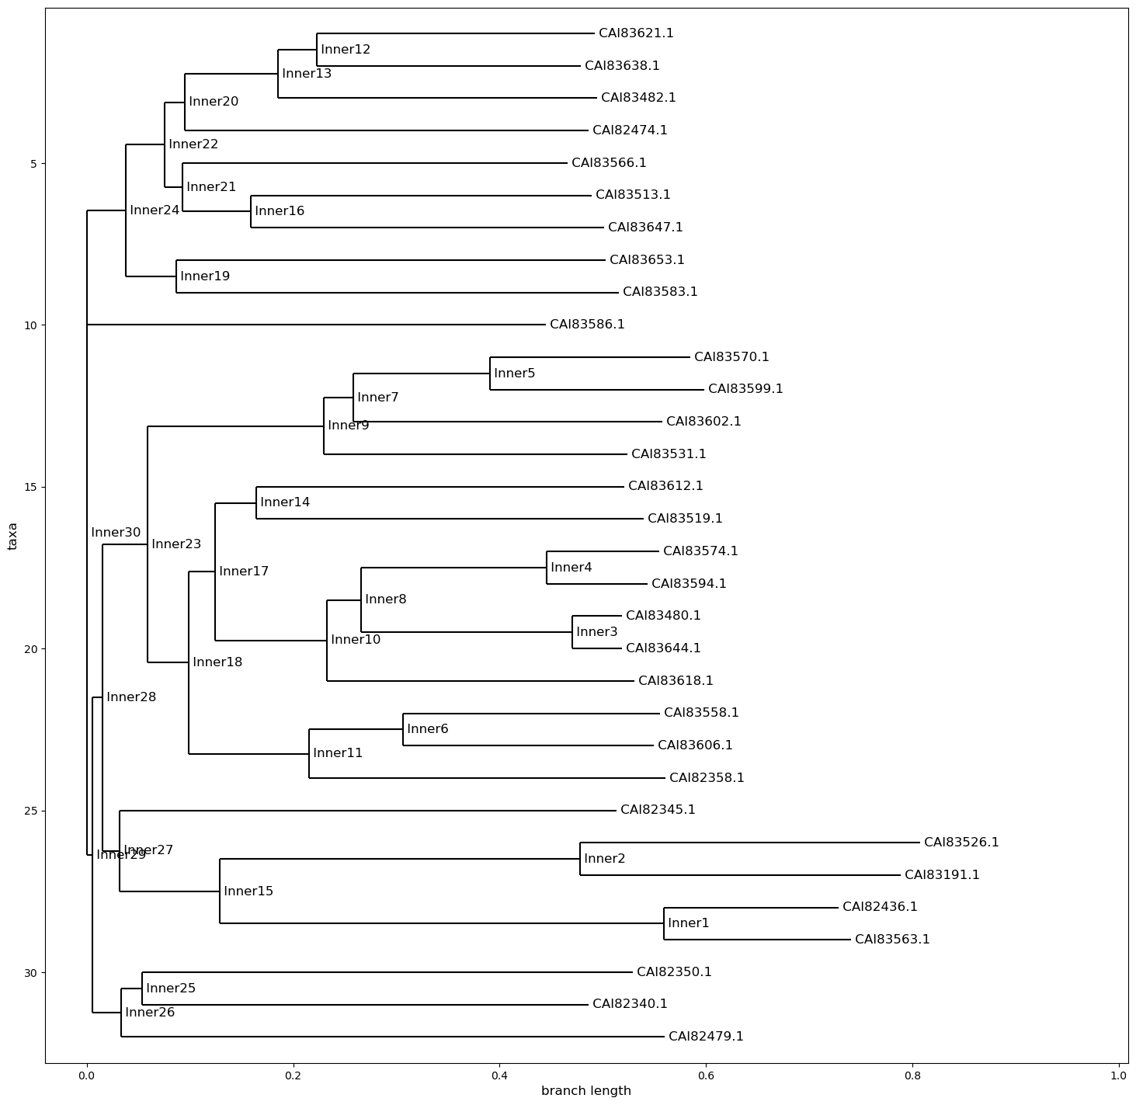
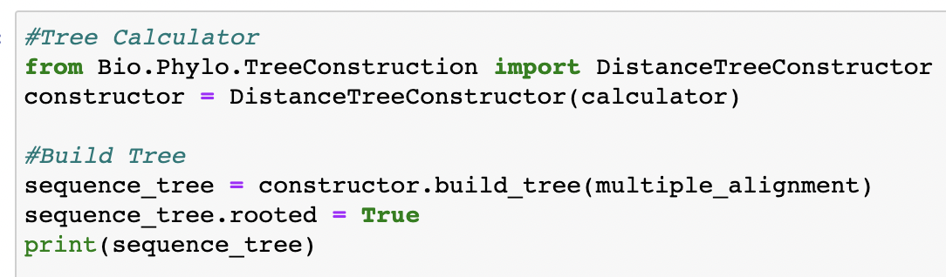
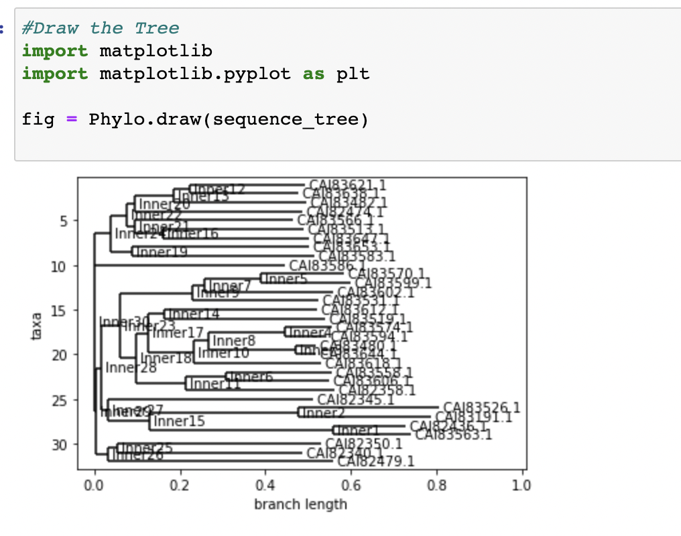
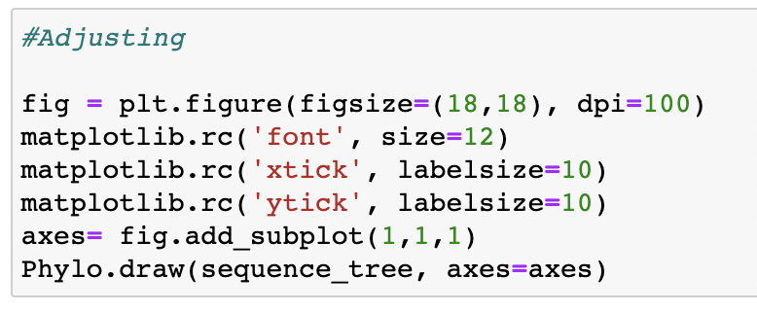
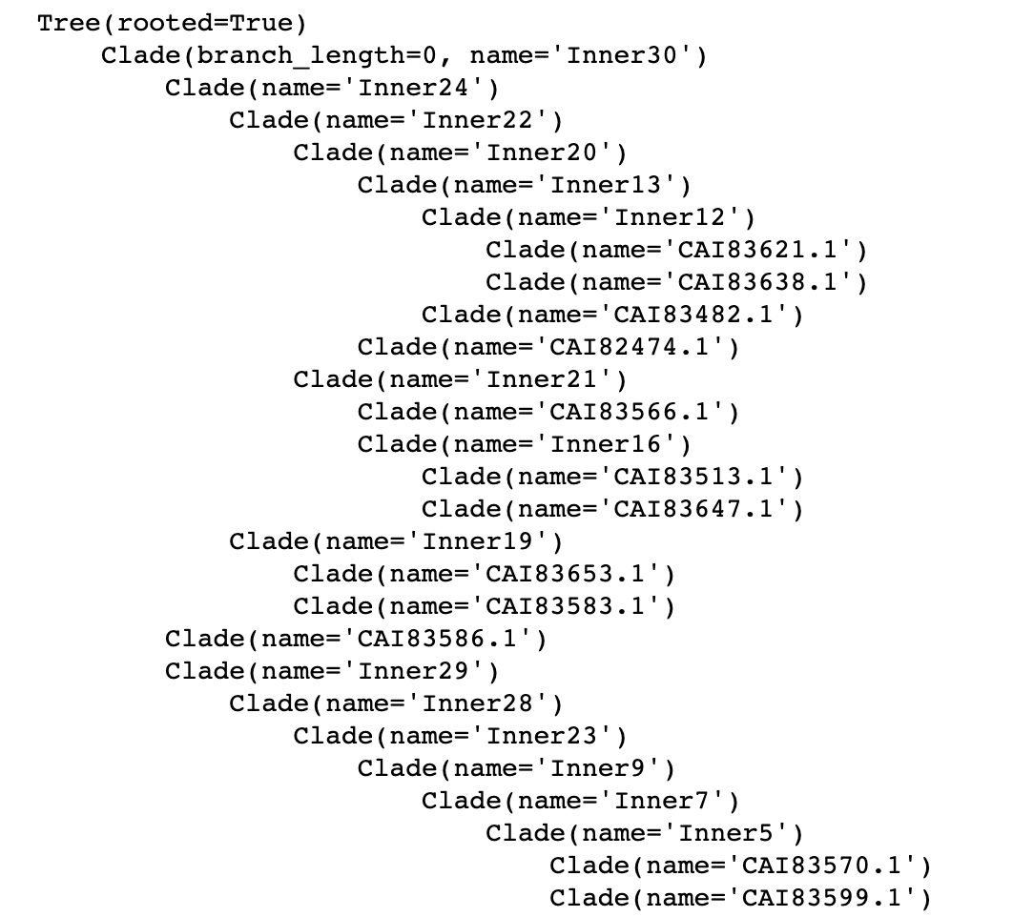
Program - Build a Phylogenetic Tree

Slide 24
Sources
Needleman SB, Wunsch CD. A general method applicable to the search for similarities in the amino acid sequence of two proteins. J Mol Biol. 1970; doi:10.1016/0022-2836(70)90057-4
Hug LA, Baker BJ, Anantharaman K, et al. A new view of the tree of life. Nat Microbiol. 2016;doi:10.1038/nmicrobiol.2016.48
Heringa, Jaap. (2008). Sequence Similarity. 10.1002/9780470015902.a0005317.pub2.
https://biopython.org/wiki/Documentation
https://www.futurelearn.com/info/courses/bacterial-genomes-bioinformatics/0/steps/47012#:~:text=The%20Genbank%20format%20allows%20for,by%20DDBJ%20(DDBJ%20format).
https://en.wikipedia.org/wiki/FASTA_format
https://www.nature.com/articles/nbt1131
https://en.wikipedia.org/wiki/Substitution_matrix
https://resources.qiagenbioinformatics.com/manuals/clcgenomicsworkbench/2000/index.php?manual=PAM30_log_odds_matrix.html
https://www.youtube.com/watch?v=wBdz3vFQ4Ks&ab_channel=TaylorReeceLindsay
https://sciencing.com/phylogenetic-tree-tell-evolutionary-relationships-animals-8589.html
https://www.researchgate.net/figure/Phylogenetic-tree-of-the-species-used-for-the-evolutionary-analysis-of-Hox-genes_fig3_245029837
https://en.wikipedia.org/wiki/Phylogenetic_tree

Slide 25
Thanks for your attention! Any questions?
All of our codes on: https://github.com/marald44/GeoBT

Slide 26
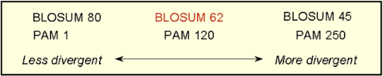
program - different kinds of distance calculator
there are different kinds of sequencincing - identity blossom pam - and they have different kinds - but we use pam 70 - because it has middle differentiatinon and it was global - not local
why choose pam 70?
pam vs blossum
http://www.bpc.uni-frankfurt.de/guentert/wiki/images/7/7c/121102_ScoringOfAlignments.pdf

Slide 27
Hier steht ein Kurztitel
22_04 Python sequence work and alignments (Biopython)
Initial python knowledge necessary
The goal is to give the other students a glimpse onto how python programming works for sequences. For that we want to download sequences from NCBI genbank and analyze them
○ Download data for a specific protein: RdhA proteins (reductive dehalogenases) as fasta-file and alternatively as genbank format. What is the difference? Use Biopython seq and seqrecord objects (https://biopython.org/wiki/Documentation) to read, manipulate and export sequences
○ Count the number of downloaded sequences, average length, length distribution, etc.
○ Do you find tools to describe the diversity of the sequences?
○ How does global alignment of protein sequences work in python?

Slide 28
Do later:
Identification of homology - last page
Calculating distance matrix - changing identity to eblosum62? - which one for global allignment? -maral
Color the tree -maral
Put similarity score on it -with pp
For similitaries another graph - what he showed today

Slide 29
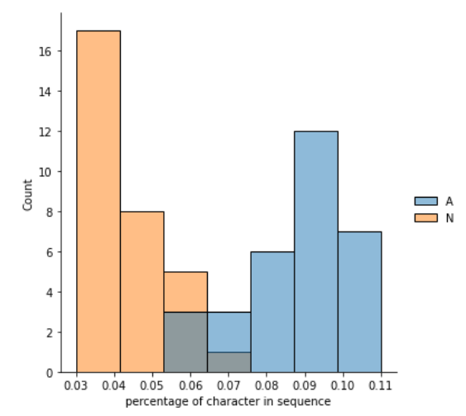
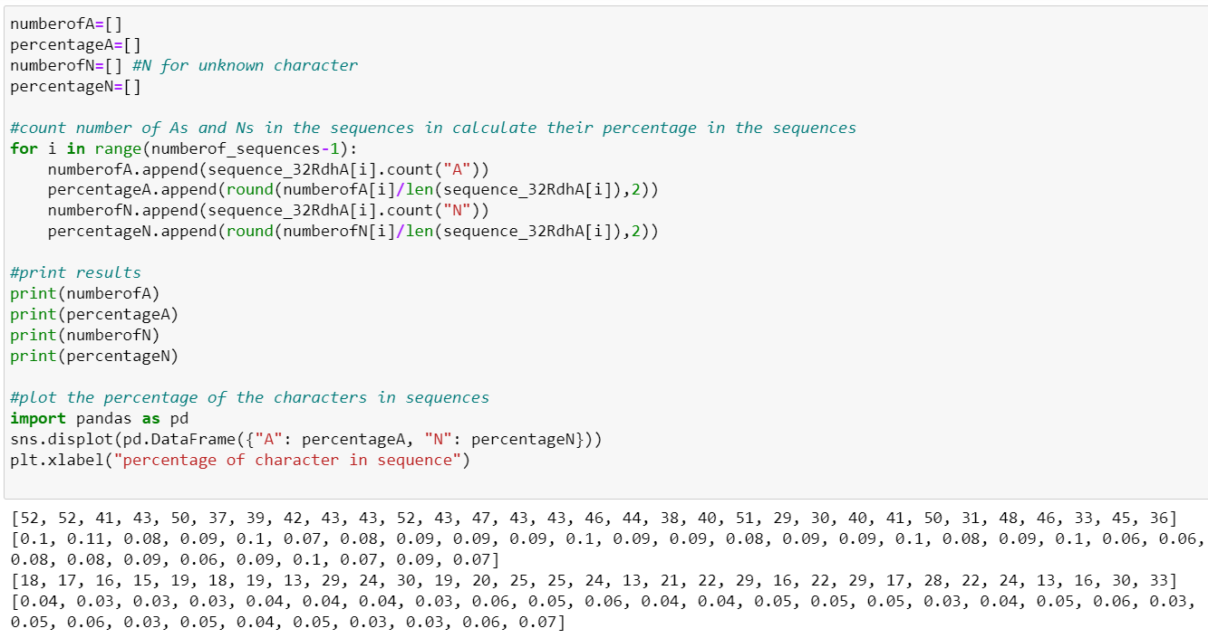
Percentage and number of character in sequence

Slide 30
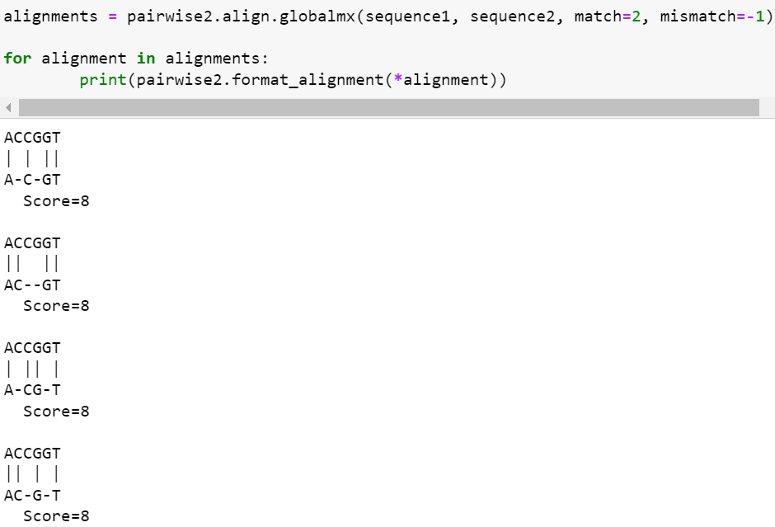
Alignments
I → match: 2
ᐧ → mismatch: -1
- → gap-penalty: 0
Notes:
Here you can see the exact same alignments, just with different scores. Because we increased the points for a match and decreased the points for a mismatch. Because the mismatch has minus points only gaps are used.

Slide 31
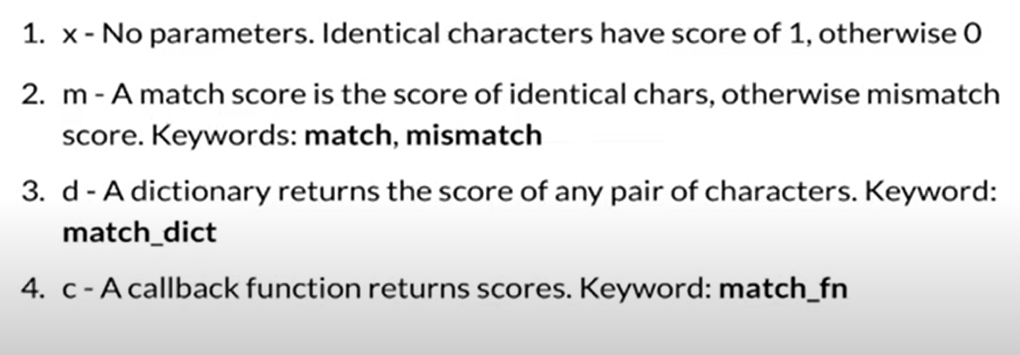
Set match and mismacht score
Notes:
https://www.youtube.com/watch?v=oxHuUdYLA7E
m→ we can give our own numbers for match and mismatch
d→get the scores from a dictonary
c→ get the scores from a callback funktion

Slide 32
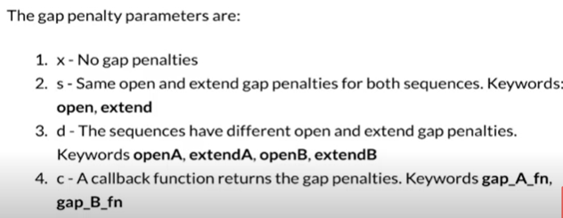
Set gap penalty

Slide 33
Gap penalty
if the penalty values are set too low, gaps can become too numerous to allow even unrelated sequences to be matches up with high similarity scores
if you are searching for similarity between distantly related sequences, the gap penalty should be set low
if the penalty values are set too high, gaps may become too difficult to appear and reasonable alignment can not be achieved, which is also unrealistic
if you are searching for sequences that are a strict match for your query sequence, the gap penalty should be set high
the most widely used gap penalty function is the affine gap penalty
Gap= Gapopen+Gapextend*(len-1)
Gaps at the end of the sequence are often treated with no penalty, because in reality many true homologous sequences are of different length

Slide 34
Sequence similarity - dynamic programming algorithm
Dynamic programming algorithm (DP) (Needleman and Wunsch (1970)) considered standard in yielding most biologically relevant alignments; modeling as Markov process (stochastic)(aa matches considered independent)
https://www.researchgate.net/profile/Jaap-Heringa/publication/227990138_Sequence_Similarity/links/5b5685470f7e9b240f0137eb/Sequence-Similarity.pdf?origin=publication_detail
Identical vs similar (similar amino acids as in aromatic, basic,... aa)
scoring matrix: evolutionary model in form of symmetrical 20x20 aa exchange matrix
each matrix stand for evolutionary prosperity for mutation of one aa type into another
Gap penalties (model of relative probabilties for occurence of insertion/deletion) -> chance of i/d depends linearly upon length of associated fragment
Scoring matrix and gap penalties produce highest scroing alignmnet of any pair of sequences: Optimal alignment
→ maybe we can find one or two other examples besides DP for sequence alignment?; one or two more sources

Slide 35
Biopython package module - Bio.pairwise2, Bio.SubsMat
https://biopython.org/docs/1.75/api/Bio.pairwise2.html
https://biopython.org/docs/1.76/api/Bio.SubsMat.html
pairwise sequence alignment using DP algorithm
functions for global and local alignments between two sequences
specification of match score and gap penalties by user (highly compatible sequences >0, incompatible sequences <0); gp <0
OR use of know matrices included in MatrixInfo from Bio.SubsMat with 41 different matrices
BLOSUM62 for distinctly related related proteins (hydrophobic matching score? https://www.sciencedirect.com/science/article/pii/S001457930203123X)
Vergleich von Blossoms
BLOSUM matrices are based on local alignments.
All BLOSUM matrices are based on observed alignments;
they are not extrapolated from comparisons of
closely related proteins.
BLOSUM stands for blocks substitution matrix.
BLOSUM62 is a matrix calculated from comparisons of
sequences with no less than 62% divergence.
BLOSUM62 is the default matrix in BLAST 2.0.
BLOSUM Matrices

Slide 36
Program - load sequences and store in lists
Bio.SeqIO as standard input/output interface for BioPython
Bio.SeqIO.parse() takes file and format name and returns SeqRecord iterator
append() adds item to the end of a list
Notes:
-> can read various file formats

Slide 37
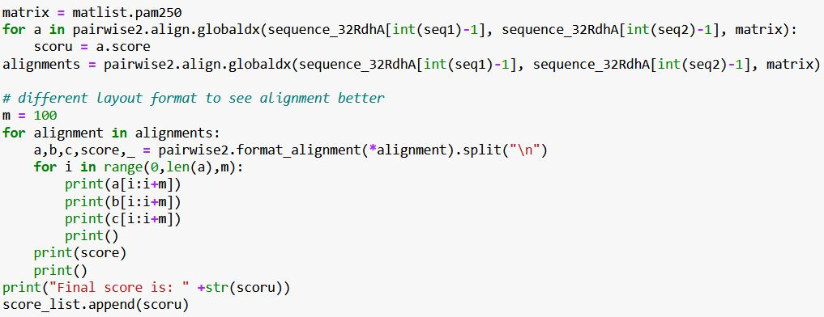
Program - pairwise global sequence alignment
MatrixInfo from Bio.SubsMat for usage of known matrices
Bio.pairwise2 module for pairwise sequence alignment using dynamic programming algorithm
object align contains all different alignment functions
format_alignment shows aligned parts of the sequences
Notes:
BLOSUM matrices are based on local alignments.
Point accepted mutation -> replacement of one singele as (likelihood of as row being replaced with as (column))
PAM250 -> 20% identity
PAM30 -> 75% identit

Slide 38
Program - export calculated stores into file

Slide 39
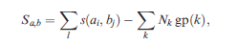
Calculating alignment scores
Exchange propensities converted into logarithmic values (log-odds)
→ Alignment score = sum of log-odd values corresponding to matched residues - appropriate gap penalties
affine gap penalty:
l matched residues, Nk number of gaps of length k, gp(k) associated gap penalty with pi and pe as penalties for gap initialization and extension

Slide 40
Nucleotide, aa properties for possible similarity score
nucleotide or aa composition
isoelectric point
molecular weight,....
→ Sequence alignment

Slide 41
General: Sequence similarity vs homology
Sequence similarity: quantification of empirical relationship of sequences using gradual scale
Homology: qualitative state; inference in presence of common ancestor between sequences hence -> divergent evolution -> orthologous genes
still enormous differences between sequence similarities within hormologous families
15-25% sequence identity referred as twilight zone compared with sequence similarities of non homologous; some even lower → sequence similarity cannot be used to prove sequences are non homologous

Slide 42
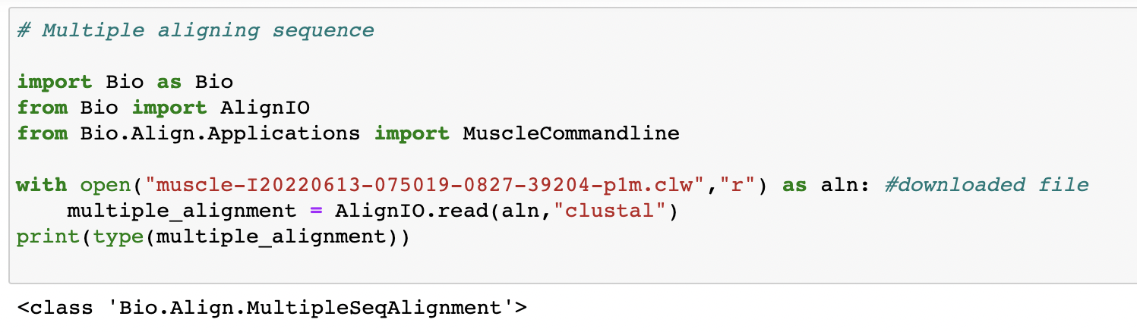
Program - Multiple Sequence Alignment with Muscle
Upload downloaded file - X.clw
Specify “Clustal” since output is in ClustalW format

Slide 43
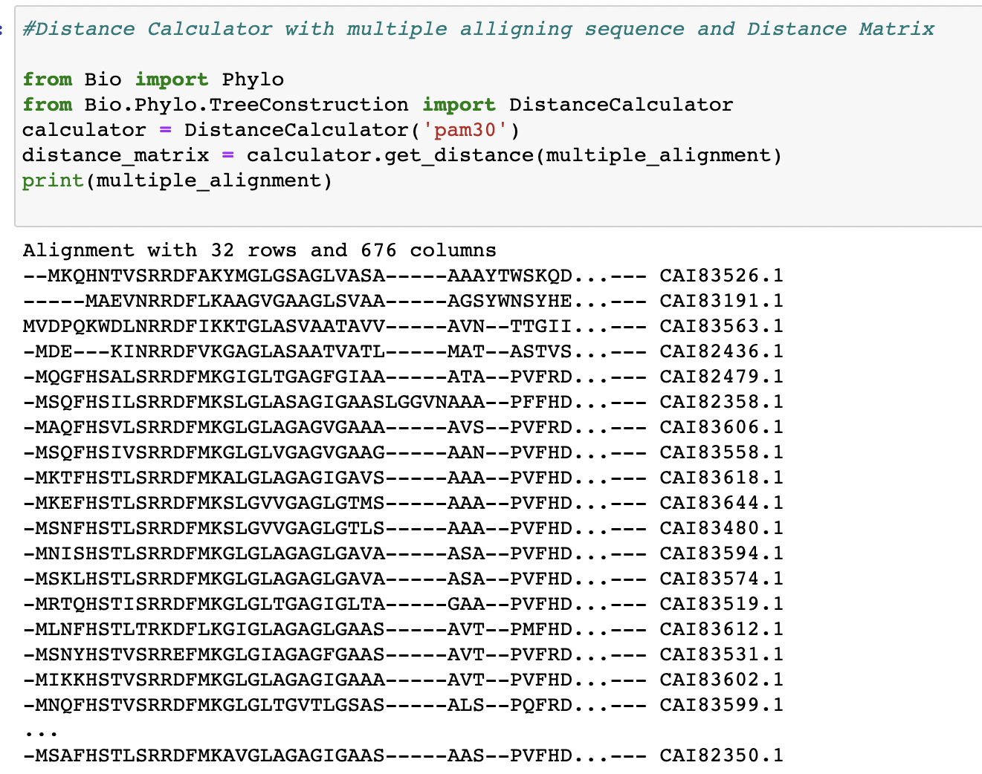
Program - Distance Calculator

Slide 44
CBDB1 why this, paper
https://pubmed.ncbi.nlm.nih.gov/16116419/

Slide 45
Problems
often too slow for repeated searches over large databases therefore development of algorithms with shortcast for speeding up like BLAST and FASTA
horizontal gene transfer or functional displacement of one gene by another within a genome not recognizable with sequence similarity

Slide 46
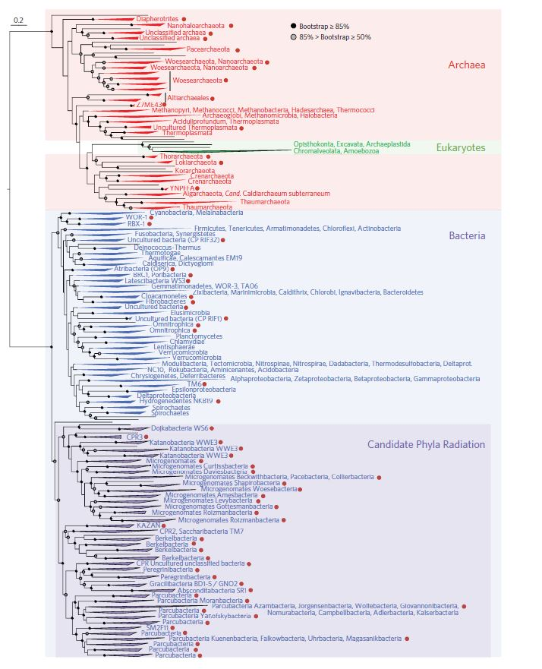
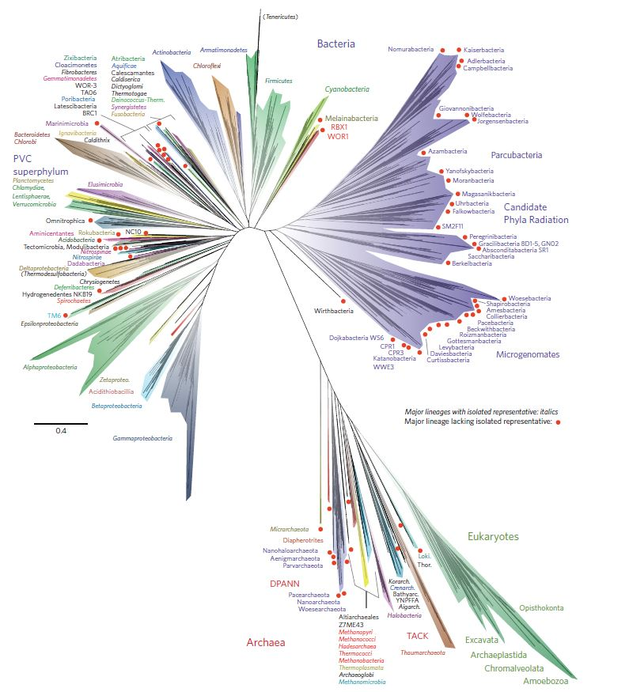
Phylogenetic tree of life

Slide 47
Ablauf Vortrag
Er stellt Verständnisfragen die sich nicht nur auf den Vortrag beziehen (z.B was machst du wenn … vorliegt, oder stellt dir vor du hast folgendes Problem…)
Fragen zu häufige Fälle/ regelfall
wenn die Studenten viele Fragen stellen stellt er keine

